Slide 1
How to use the Places Map Widget in Primo VE NDE
A Live Demo and overall introduction
Yoel Kortick | May 2026

Slide 2
Agenda
  Introduction
  Enabling the Places Map Widget
  Example 1 (using 034 field)
  Example 2 (using 034 field)
  Example 3 (using 034 field)
  Example 4 (using 034 field)
  Example 5 (using 651_0 field subfield a)
  Example 6 (using 651_0 field subfield a)

Slide 3

Introduction

Slide 4
Introduction
The Places Map Widget uses geographic coordinates derived from bibliographic metadata to display a map of the designated location, thereby improveing geographic discovery for places and organizations.
The Places Map Widget feature appears in the record's full display.
The Widget appears when either
  Geographical coordinates are included in the subfields of the KORMARC/MARC21 field 034 and the UNIMARC field 123.
  A 651_0 field subfield a links to a geographic location for a MARC21 record
  A 650_0 field subfield z links to a geographic location for a MARC21 record
Rather than explain in depth here what the Places Map Widget does, let’s do a live demo and take a look.
In addition to this presentation see also “The Enable Places Map Widget check box” at Configuration Changes for the Full Record Display Page, part of Overview of the NDE Interface and Configuration.

Slide 5
Enabling the Places Map Widget

Slide 6
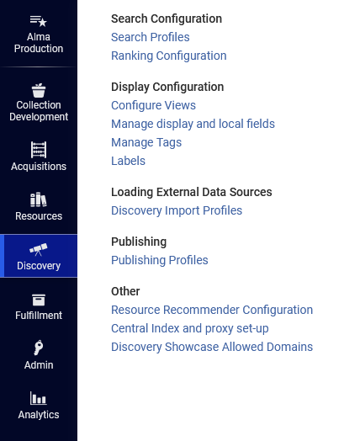
Enabling the Places Map Widget
We will now enable the Enable Places Map Widget in the Primo VE NDE view EXLDEV1_INST:Alma_NDE.
Access the view at “Discovery > Display Configuration > Configure Views”

Slide 7
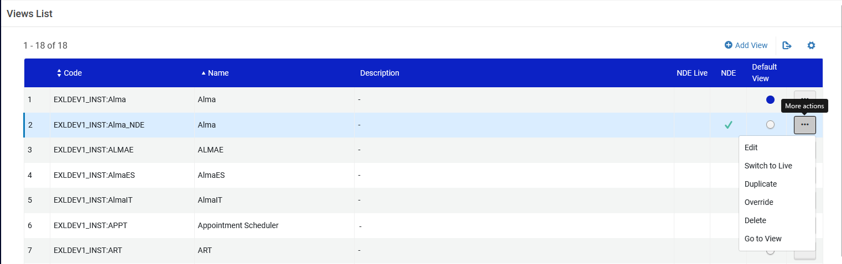
Enabling the Places Map Widget
Edit the View

Slide 8
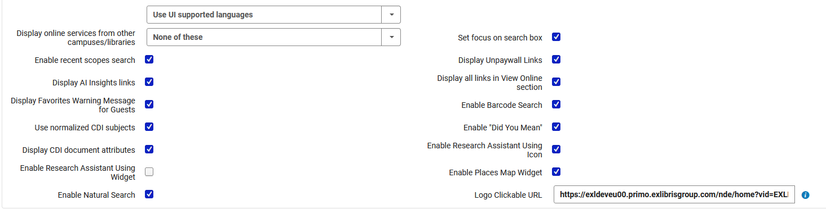
Enabling the Places Map Widget
Enabling the Places Map Widget

Slide 9
Example 1 (using 034 field)

Slide 10
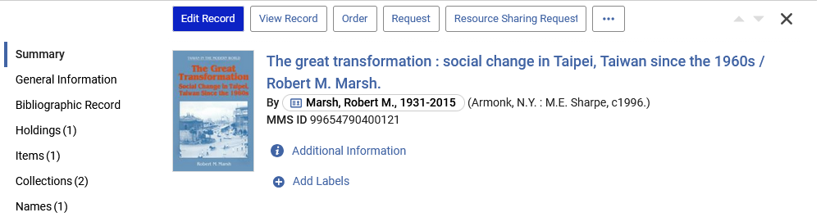
Example 1 (using 034 field)
We have a MARC21 record with title “The great transformation : social change in Taipei, Taiwan since the 1960s”

Slide 11
Example 1 (using 034 field)
We want to add a 034 Coded Cartographic Mathematical Data field for “Taipei Taiwan” and include the following subfields so that the Places Map Widget will display in the full record view:
  $d - Coordinates - westernmost longitude (NR)
  $e - Coordinates - easternmost longitude (NR)
  $f - Coordinates - northernmost latitude (NR)
  $g - Coordinates - southernmost latitude (NR)

Slide 12
Example 1 (using 034 field)
We ascertain what the coordinates are and catalog them in the bibliographic record.
The 034 field will be as follows:
0341_ $$d E1213000 $$e E1214000 $$f N0250000 $$g N0251000

Slide 13
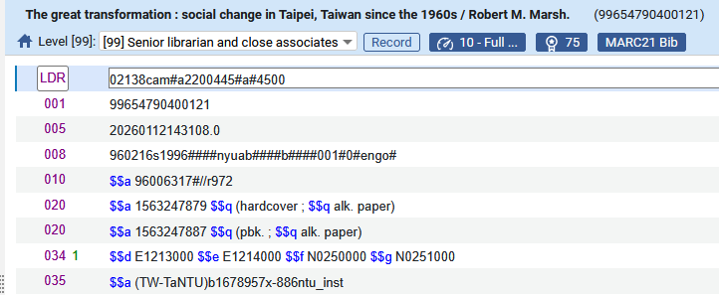
Example 1 (using 034 field)
Now we have catalogued the 034 field:

Slide 14
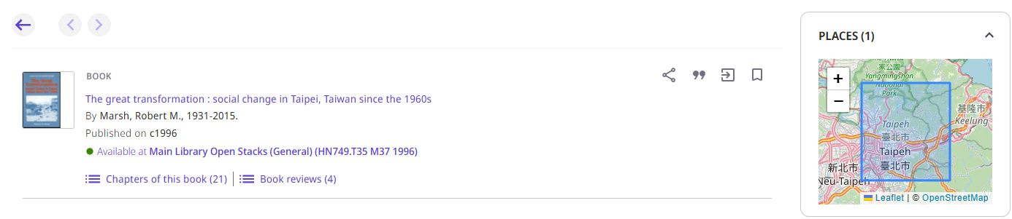
Example 1 (using 034 field)
In the full record view, we see the Places Map Widget for Taipei, Taiwan
We also have a link to
https://leafletjs.com/
https://www.openstreetmap.org/

Slide 15
Example 2 (using 034 field)

Slide 16
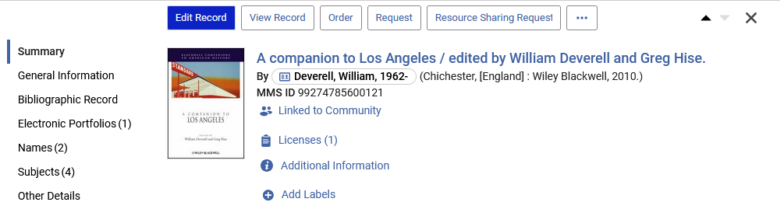
Example 2 (using 034 field)
We have a MARC21 record with title “A companion to Los Angeles”
By the way, this is a CZ record

Slide 17
Example 2 (using 034 field)
We want to add a 034 Coded Cartographic Mathematical Data field for “Los Angeles, California” and include the following subfields so that the Places Map Widget will display in the full record view:
  $d - Coordinates - westernmost longitude (NR)
  $e - Coordinates - easternmost longitude (NR)
  $f - Coordinates - northernmost latitude (NR)
  $g - Coordinates - southernmost latitude (NR)

Slide 18
Example 2 (using 034 field)
We ascertain what the coordinates are and catalog them in the bibliographic record.
The 034 field will be as follows:
034__ $$a a $$b 100000 $$d W1183000 $$e W1180000 $$f N0341000 $$g N0335000

Slide 19
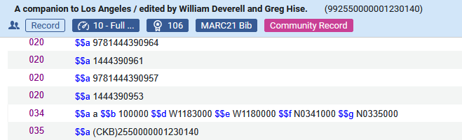
Example 2 (using 034 field)
Now we have catalogued the 034 field:

Slide 20
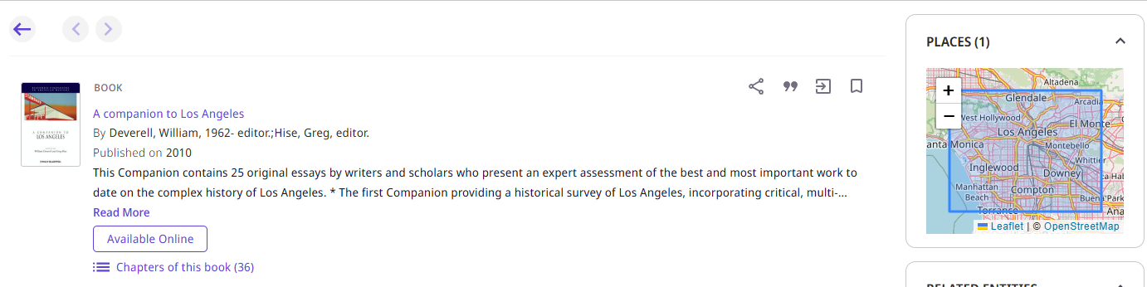
Example 2 (using 034 field)
In the full record view, we see the Places Map Widget for Los Angeles, California
We also have a link to
https://leafletjs.com/
https://www.openstreetmap.org/

Slide 21
Example 3 (using 034 field)

Slide 22
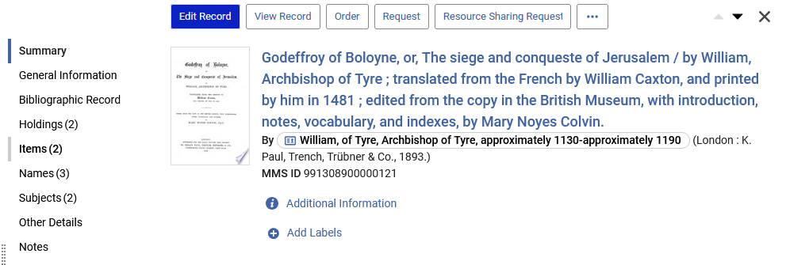
Example 3 (using 034 field)
We have a MARC21 record with title “Godeffroy of Boloyne, or, The siege and conqueste of Jerusalem”

Slide 23
Example 3 (using 034 field)
We want to add a 034 Coded Cartographic Mathematical Data field for “Jerusalem, Israel” and include the following subfields so that the Places Map Widget will display in the full record view:
  $d - Coordinates - westernmost longitude (NR)
  $e - Coordinates - easternmost longitude (NR)
  $f - Coordinates - northernmost latitude (NR)
  $g - Coordinates - southernmost latitude (NR)

Slide 24
Example 3 (using 034 field)
We ascertain what the coordinates are and catalog them in the bibliographic record.
The 034 field will be as follows:
0341_ $$a a $$b 50000 $$d E0351000 $$e E0351800 $$f N0315000 $$g N0314000

Slide 25
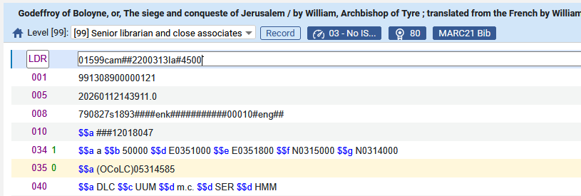
Example 3 (using 034 field)
Now we have catalogued the 034 field:

Slide 26
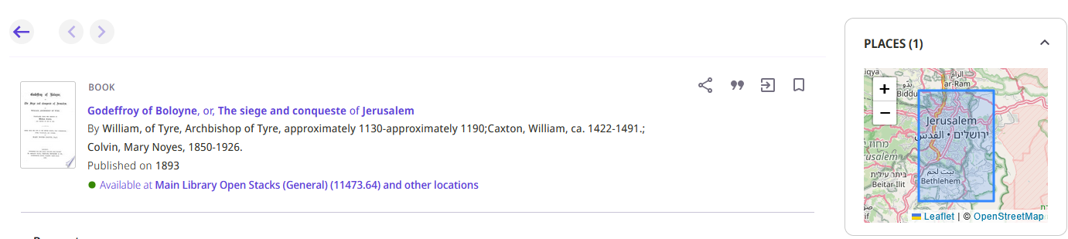
Example 3 (using 034 field)
In the full record view, we see the Places Map Widget for Jerusalem, Israel
We also have a link to
https://leafletjs.com/
https://www.openstreetmap.org/

Slide 27
Example 4 (using 034 field)

Slide 28
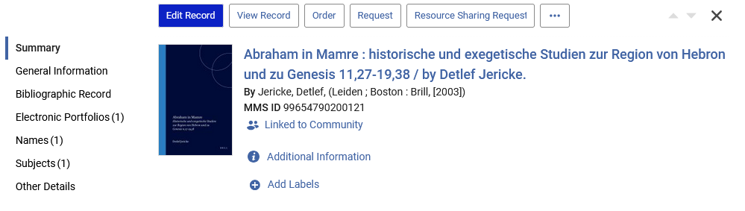
Example 4 (using 034 field)
We have a MARC21 record with title “Abraham in Mamre : historische und exegetische Studien zur Region von Hebron und zu Genesis 11,27-19,38”
By the way, this is a CZ record

Slide 29
Example 4 (using 034 field)
We want to add a 034 Coded Cartographic Mathematical Data field for “Hebron, Israel” and include the following subfields so that the Places Map Widget will display in the full record view:
  $d - Coordinates - westernmost longitude (NR)
  $e - Coordinates - easternmost longitude (NR)
  $f - Coordinates - northernmost latitude (NR)
  $g - Coordinates - southernmost latitude (NR)

Slide 30
Example 4 (using 034 field)
We ascertain what the coordinates are and catalog them in the bibliographic record.
The 034 field will be as follows:
0341_ $$a a $$b 50000 $$d E0350400 $$e E0351200 $$f N0313400 $$g N0313000

Slide 31
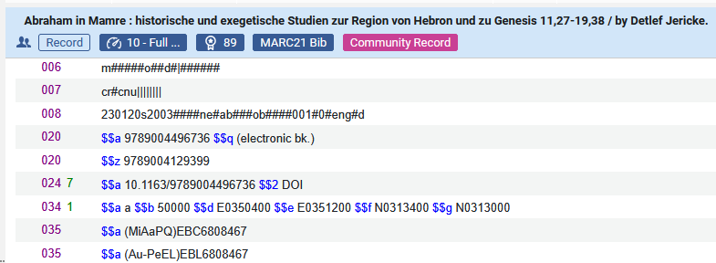
Example 4 (using 034 field)
Now we have catalogued the 034 field:

Slide 32
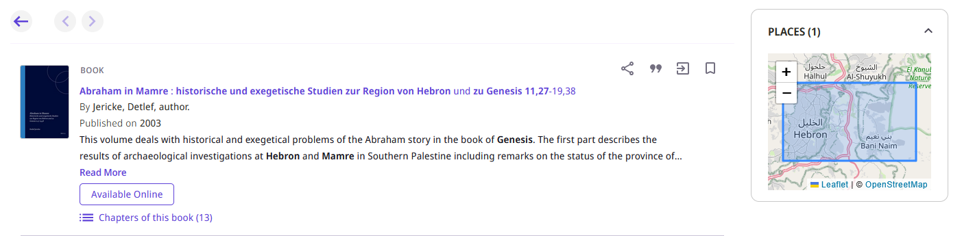
Example 4 (using 034 field)
In the full record view, we see the Places Map Widget for Hebron, Israel
We also have a link to
https://leafletjs.com/
https://www.openstreetmap.org/

Slide 33
Example 5 (using 651_0 field subfield a)

Slide 34
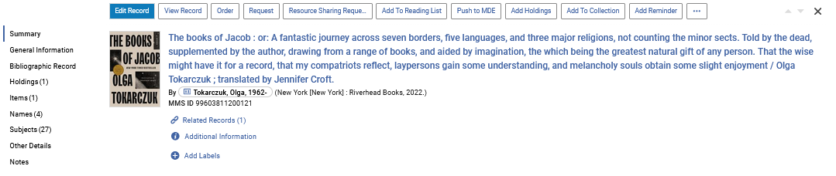
Example 5 (using 651_0 field subfield a)
We have a MARC21 record with title “The books of Jacob : or: A fantastic journey across seven borders, five languages, and three major religions …”

Slide 35
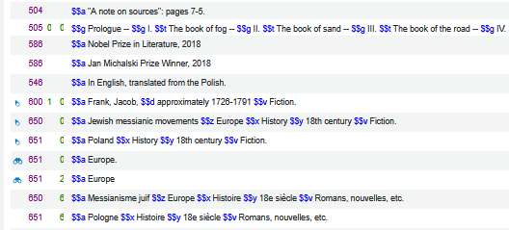
Example 5 (using 651_0 field subfield a)
Now we have catalogued the 651_0 field, and it is linked to an authority record.
We have one for Europe and one for Poland.
The linked authority records link to the map coordinates and thus the map widget will appear in Primo VE NDE Discovery

Slide 36
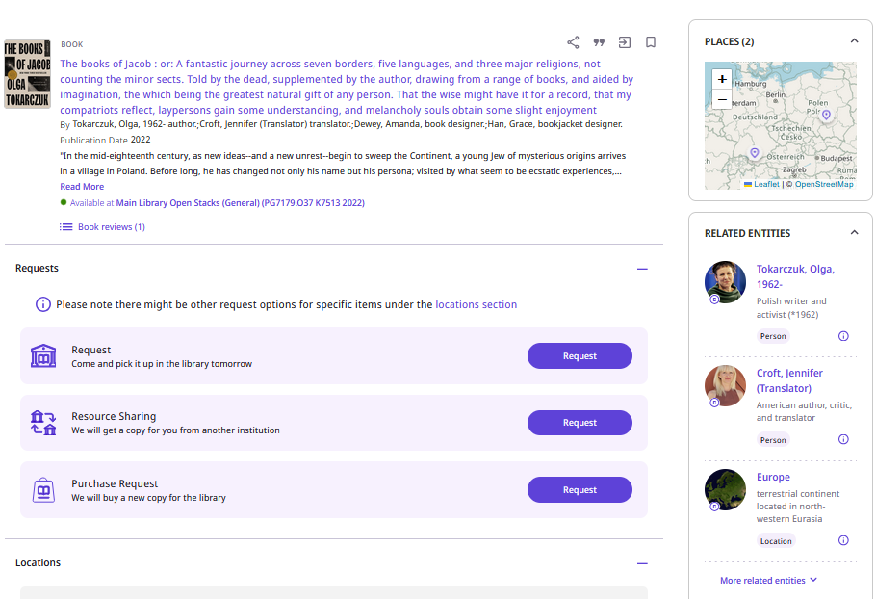
Example 5 (using 651_0 field subfield a)
In the full record view, we see the Places Map Widget for Europe
Both “Europe” and “Poland” appears as keys in the map (for each of the 651_0 fields linked authority records which link to the map coordinates.)
We also have a link to
https://leafletjs.com/
https://www.openstreetmap.org/

Slide 37

Example 5 (using 651_0 field subfield a)
Let’s see why Poland and Europe appear in the map widget.
The heading with 651_0 $$a Europe links to LC authority record with identifier “sh 85045631”
The heading with 651_0 $$a Poland links to LC authority record with identifier “n 79131071”

Slide 38
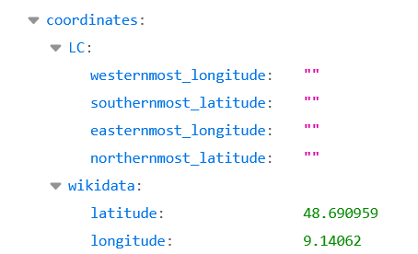
Example 5 (using 651_0 field subfield a)
This API runs for “sh 85045631” for Europe and brings the coordinates from WikiData and displays the map widget in Primo
https://cdi-api.summon.serialssolutions.com/eautocomplete/entity/get?id=sh85045631&multiLang=true

Slide 39
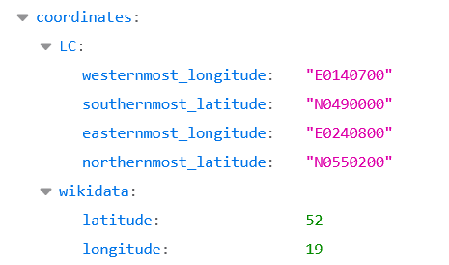
Example 5 (using 651_0 field subfield a)
This API runs for “n 79131071” for Poland and brings the coordinates from WikiData and displays the map widget in Primo
https://cdi-api.summon.serialssolutions.com/eautocomplete/entity/get?id=n79131071&multiLang=true

Slide 40
Example 6 (using 651_0 field subfield a)

Slide 41
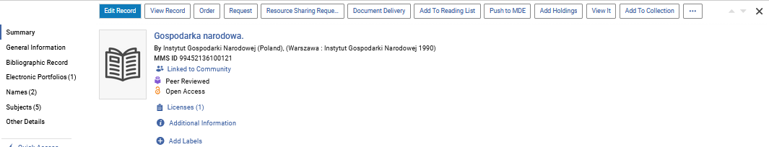
Example 6 (using 651_0 field subfield a)
We have a MARC21 record with title “Gospodarka narodowa (Warsaw, Poland : 1990)”

Slide 42
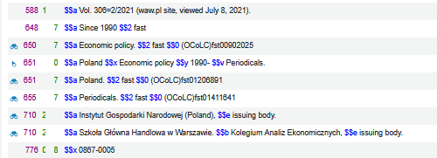
Example 6 (using 651_0 field subfield a)
Now we have catalogued the 651_0 field, and it is linked to an authority record.
We have one for Poland.
The linked authority record has the map coordinates and thus the map widget will appear in Primo VE NDE Discovery

Slide 43
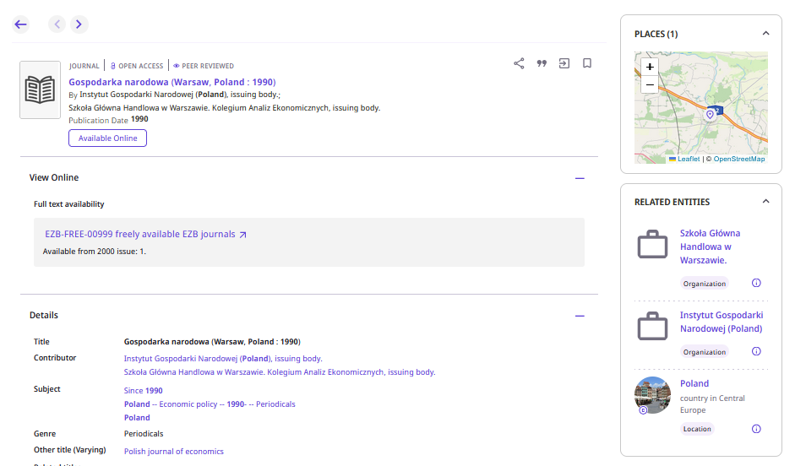
Example 6 (using 651_0 field subfield a)
“Poland” appears as a key in the map (for the 651_0 field linked authority record which contains links to the map coordinates).
In the full record view, we see the Places Map Widget for Poland
We also have a link to
https://leafletjs.com/
https://www.openstreetmap.org/

Slide 44
Example 6 (using 651_0 field subfield a)
Let’s see why Poland appears in the map widget.
The heading with 651_0 $$a Poland links to LC authority record with identifier “n 79131071”

Slide 45
Example 6 (using 651_0 field subfield a)
This API runs for “n 79131071” for Krakow and brings the coordinates from WikiData and displays the map widget in Primo
https://cdi-api.summon.serialssolutions.com/eautocomplete/entity/get?id=n79131071&multiLang=true

Slide 46
Thank You

